Slide 1

Final Project presentation
Sharon Jepkosgei

Slide 2
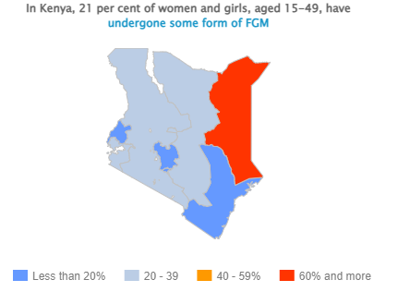
introduction
Female Genital Mutilation (FGM) affects at least 200 million women and girls in 31 countries worldwide.
21% Kenya girls aged 15 to 49

Slide 3
PROBLEM
About three years ago, we started an initiative to help victims of Female Genital Mutilation (FGM).
Since its inception, our program has grown significantly, and we are now faced with the challenge of efficiently placing girls in different centers and homes.
For instance, girls are constantly being moved to different locations to accommodate their needs.

Slide 4
My Project
The “EmpowerHer" Placement tool:
For my project, I created a program to calculate and rank the best-matched placement centers for FGM survivors
Based on weighted characteristics that encompass both the services offered by the centers and the unique needs of each girl.
DEMO

